Slide 1
Hierarchical Hybrid Search Structure for High Performance Packet Classification
Authors : O˜guzhan Erdem, Hoang Le, Viktor K. Prasanna
Publisher :INFOCOM, 2012 Proceedings IEEE
Presenter : Kai-Hsun Li
Date : 2015/7/22
Department of Computer Science and Information Engineering
National Cheng Kung University, Taiwan R.O.C.
Notes:
1

Slide 2
Introduction
Pipelined hardware implementation of Hierarchical algorithms has two disadvantages: (1) backtracking which requires stalling the pipeline and (2) inefficient memory usage due to variation in the size of the trie nodes.
We propose a clustering algorithm that can partition a given rule database into a fixed number of clusters to eliminate backtracking in the state-of-the-art hierarchical search structures.

Slide 3
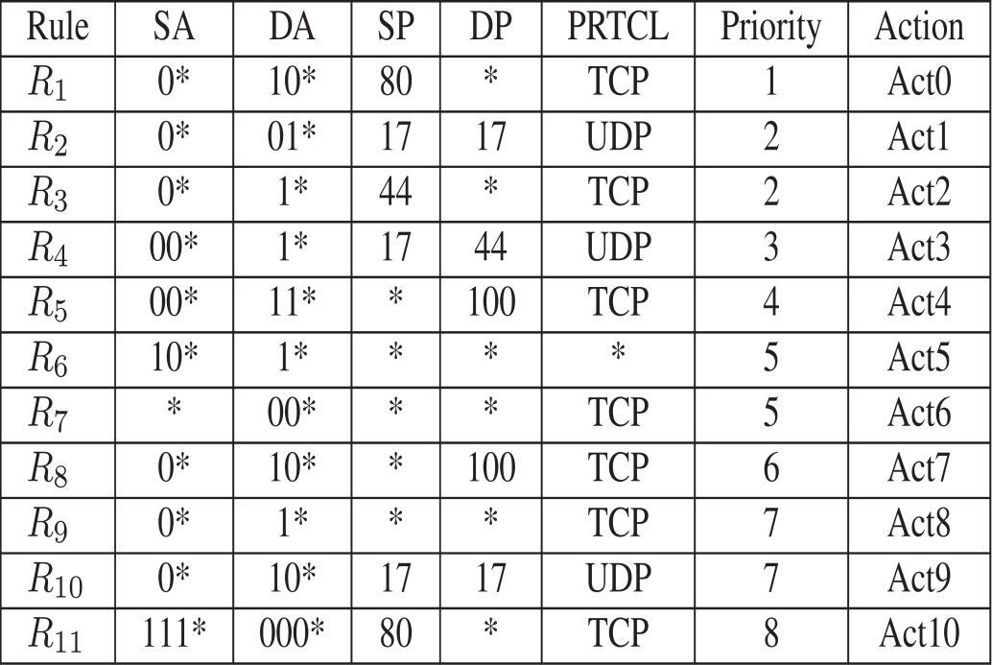
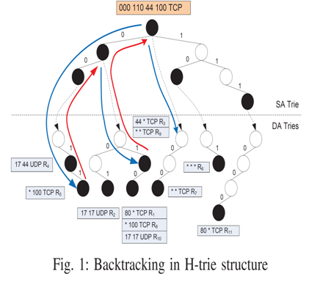
Background
Table I: Sample 5-field ruleset

Slide 4
Proposed Scheme(1/6)
-
We propose a hierarchical search structure which consists of 2 stages:
  Stage 1 (SA tree): A binary search tree (BST) is built for
  each cluster using the SA prefixes.
  Stage 2 (DA trie): Each node of the SA trees connects to a
  DA trie.

Slide 5
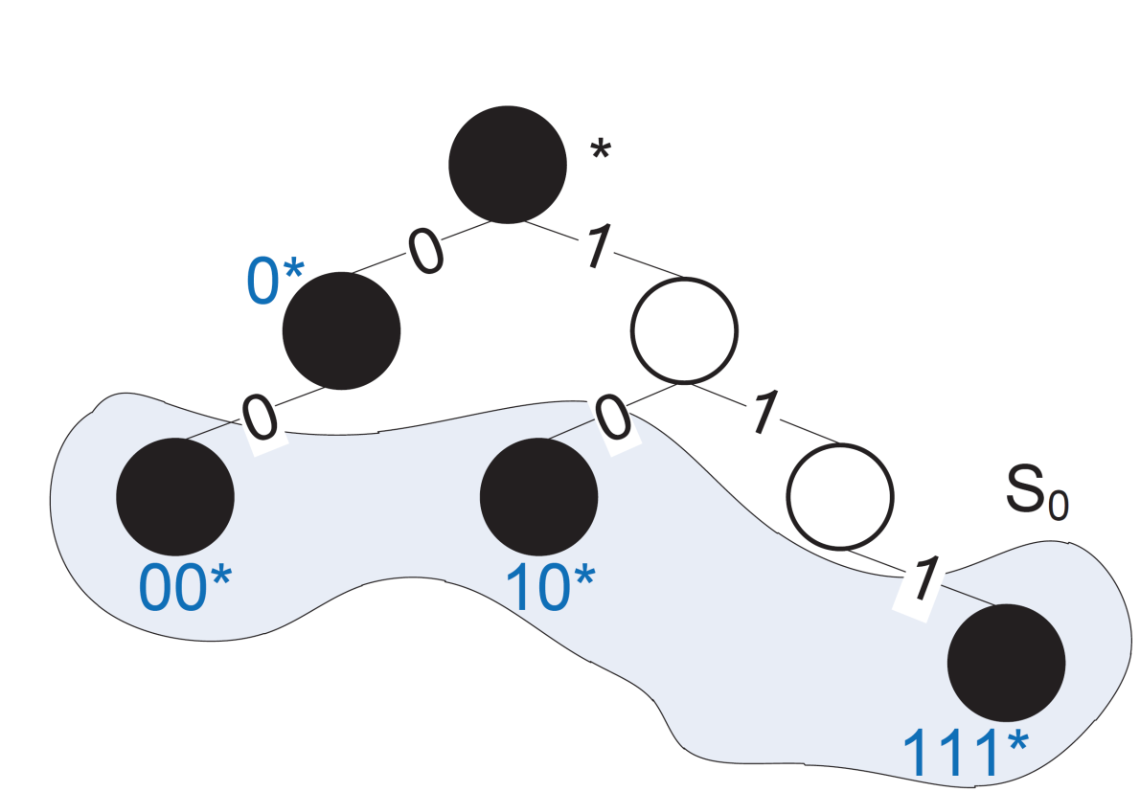
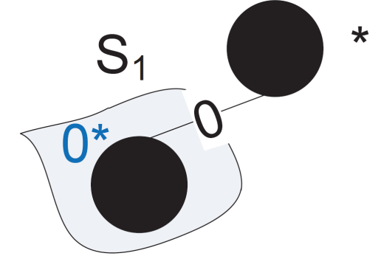
Proposed Scheme(2/6)
- Stage 1
S0
00*
10*
111*
Notes:
Stage1分cluster的方法跟dynamic routing table一樣，然後建binary search tree

Slide 6
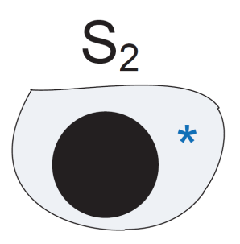
Proposed Scheme(2/6)
- Stage 1
S0
00*
10*
111*
S1
0*

Slide 7
Proposed Scheme(2/6)
- Stage 1
S0
00*
10*
111*
S1
S2
0*
*

Slide 8
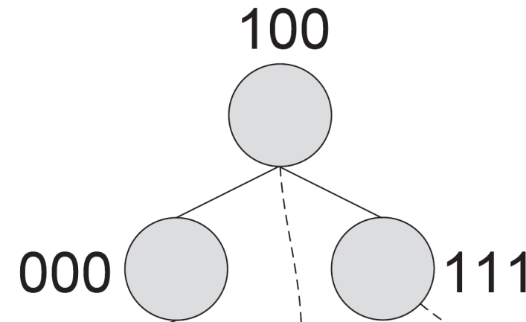
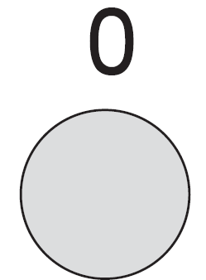
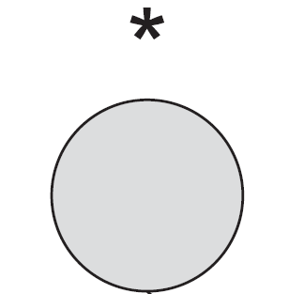
Proposed Scheme(3/6)
- Stage 1

Slide 9
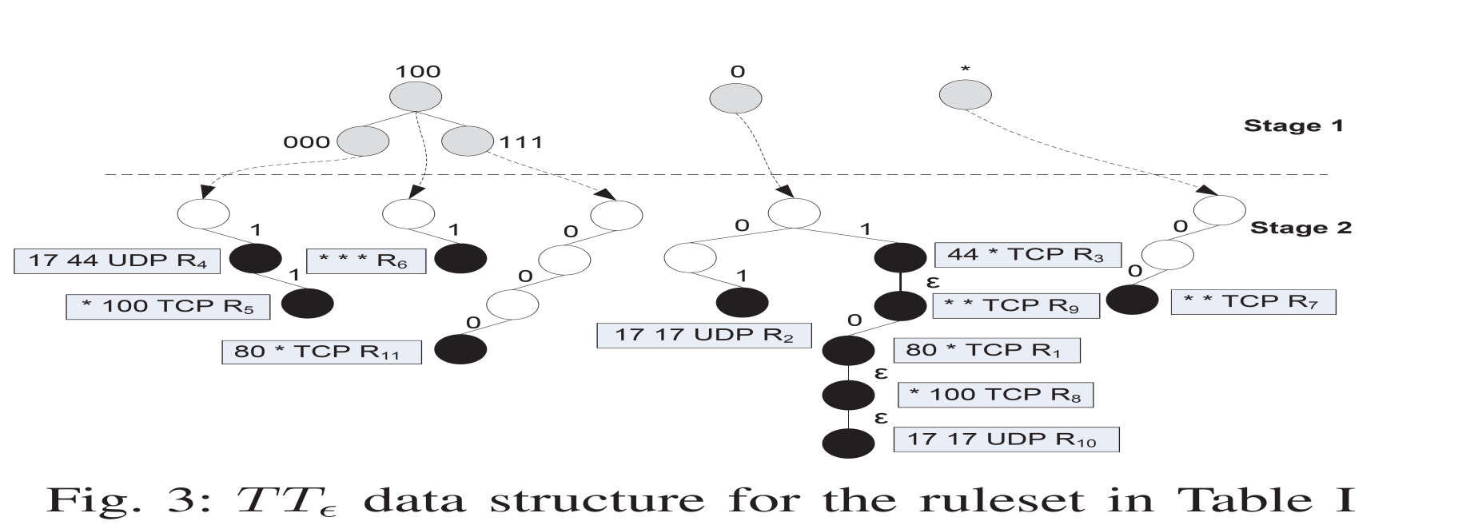

Proposed Scheme(4/6)
-stage2
Ptrie = 1
Notes:
Ptrie類似bucket size，但這邊的rule數是num of overlapped rules
而這裡因為Ptrie=1，所以R1、R8、R10只能各別在建立一個node來存放

Slide 10
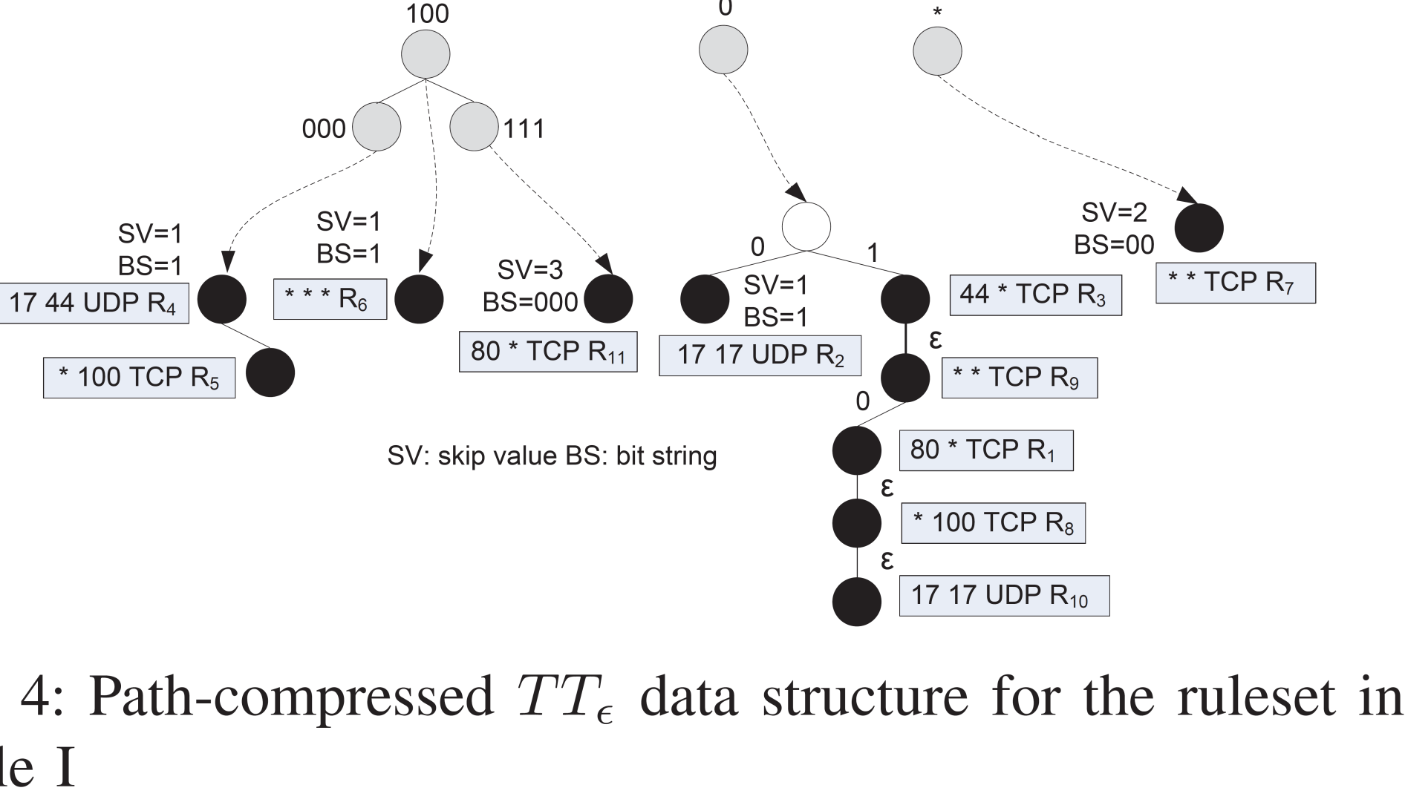
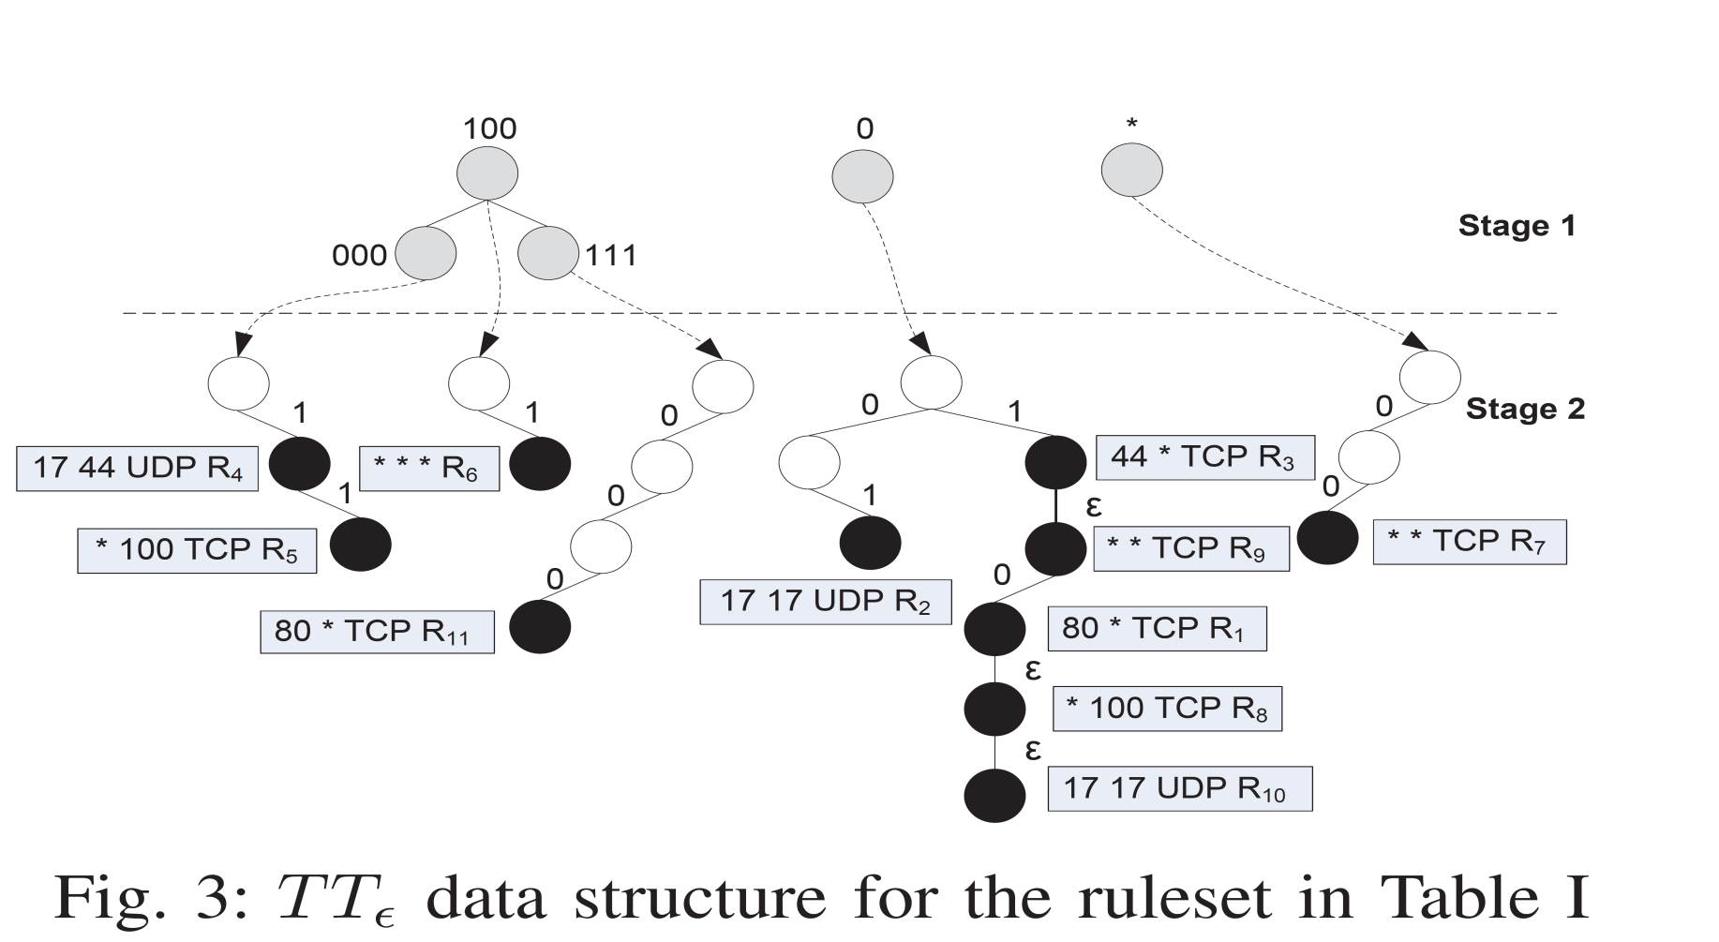
Proposed Scheme(5/6)
-Path Compression
Notes:
這邊他利用path compression來減少node數，來達到更好的memory usage
SV是紀錄減少了幾bits
BS則是表示原本要走0 or 1才會match該rule

Slide 11
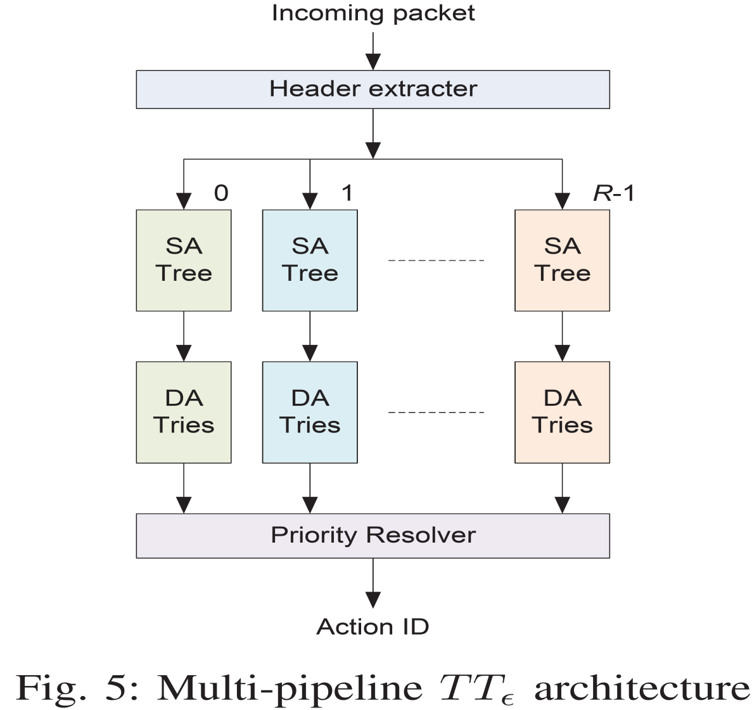
Proposed Scheme(6/6)
Notes:
Pipeline的數量取決於cluster的數量

Slide 12
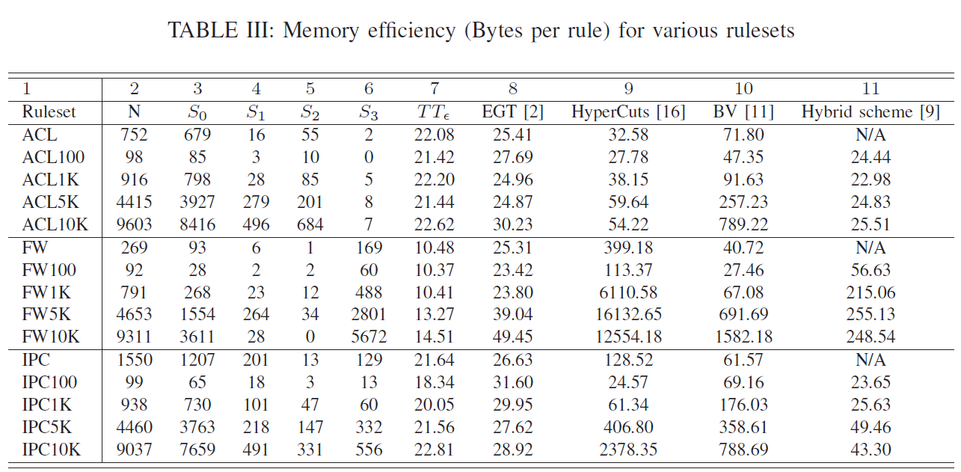
EXPERIMENTAL RESULTS(1/4)
Notes:
2代表rule set 的rule 數
3~6代表分到此cluster的rule 數，只分4個是因為照他的alg分到第4個cluser(S3)時，SA通常的prifix通常只有*
他這邊

Slide 13
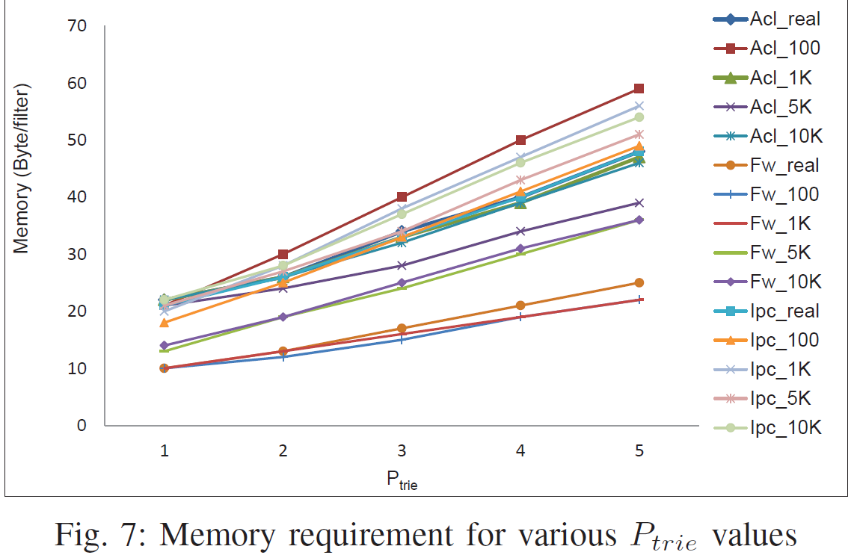
EXPERIMENTAL RESULTS(2/4)

Slide 14
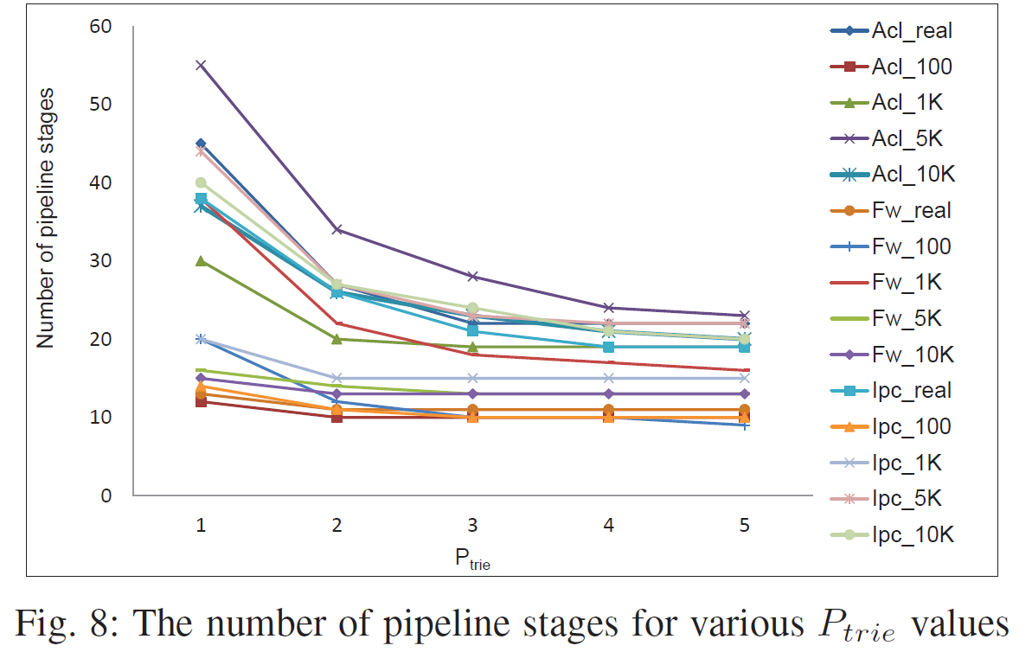
EXPERIMENTAL RESULTS(3/4)

Slide 15
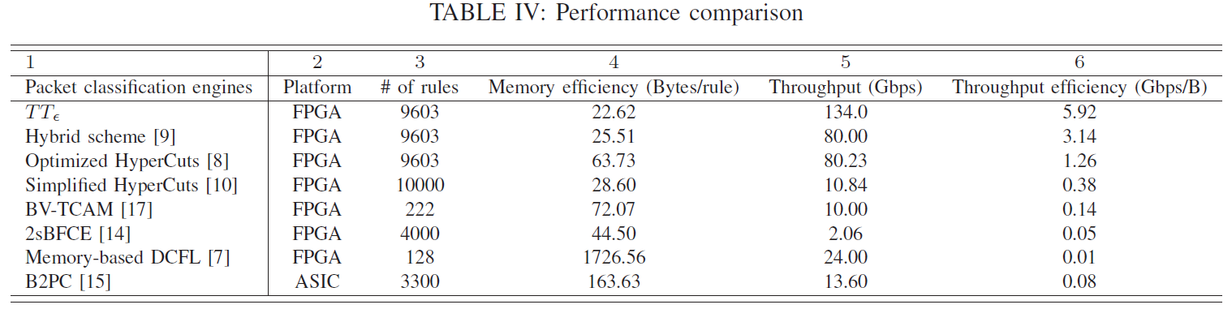
EXPERIMENTAL RESULTS(4/4)

